Slide 1






DATA-DRIVEN CREDIT CARD ANALYTICS
A Business Intelligence & Customer Insight Dashboard
By Pranav Patel (22CS060) | Internship at Electrosoft
Mentor: Mr. Divyang Shah(Founder & CEO of Electrosoft)

Slide 2


PROJECT OVERVIEW
To analyze credit card transactions and customer behavior patterns.
To identify top-performing cards, customer segments, and usage trends.
To provide actionable insights that help improve revenue and engagement.
To visualize key metrics through interactive Power BI dashboards.
Tools: Power BI, SQL, Excel
Dataset Size:~ 10,000 Credit Card Records
01

Slide 3

DATASET OVERVIEW
Source: Simulated credit card dataset containing 10,000 records.
Key Columns:
Client_Num, Card_Category, Use Chip, Exp Type, Total_Trans_Amt, Interest_Earned, Customer_Job, Income, Education_Level, Marital_Status, Age_Group, State
Coverage: Transactions from Q1 to Q4 (2023).
Cleaned and processed before import to Power BI.
02

Slide 4
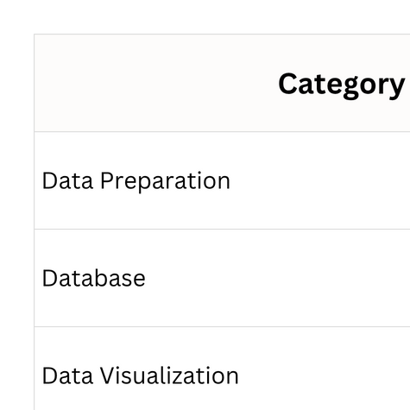


TOOLS & TECHNOLOGIES
03

Slide 5
DASHBOARD 1: CREDIT CARD TRANSACTION REPORT
Purpose: Analyze overall transaction performance and revenue contribution.
Key KPIs:
Total Revenue: $12M
Total Interest: $8M
Transaction Volume: 656K
Transaction Amount: $45M
Key Insights:
Blue Card dominates with $9.9M revenue (≈ 83% of total).
Swipe Transactions generate the most revenue ($7.6M).
Top 3 Expense Types:
Bills ($3.0M)
Entertainment ($2.1M)
Fuel ($2.0M)
Q3 had the highest quarterly revenue ($3.0M).
04

Slide 6

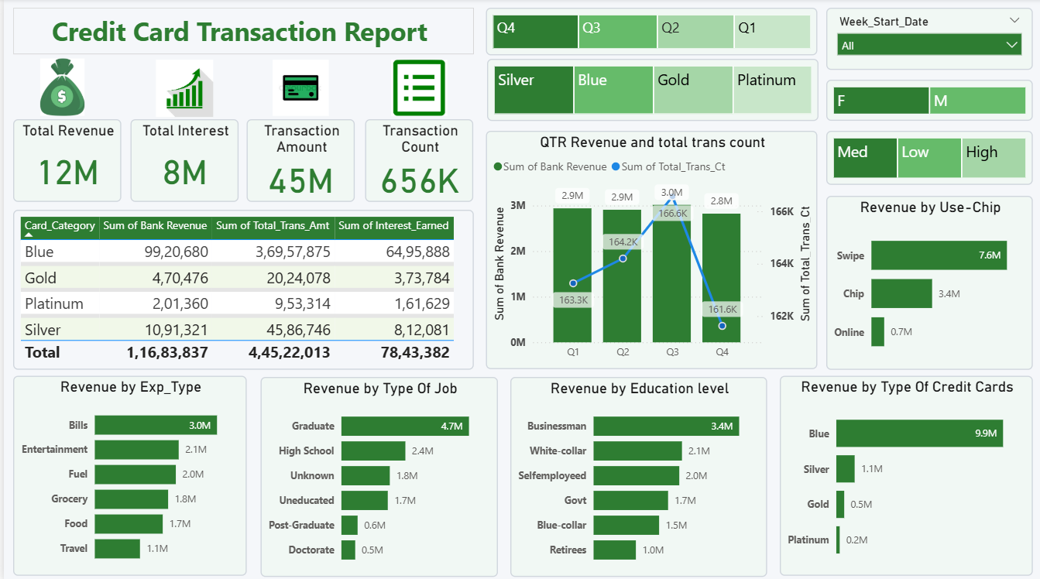
DASHBOARD 1: CREDIT CARD TRANSACTION REPORT
05

Slide 7
DASHBOARD 2: CREDIT CARD CUSTOMER REPORT
Purpose: Analyze customer demographics and gender-based spending behavior.
Key Metrics:
Total Income: $576M
Customer Satisfaction Score (CSS): 3.19
Insights:
Businessmen ($3.3M) and White-collar employees ($2.1M) are the top job contributors.
Age Group 40–50 dominates spending with a combined $5.2M revenue, driven by both genders.
High-income customers generate $4.2M, accounting for the largest share.
Married customers spend more ($3.0M) compared to singles ($2.5M).
Top 3 States:
California (CA): $1.5M
Texas (TX): $1.4M
New York (NY): $1.3M
Each bar visual shows Female (Light Pink) vs Male (Dark Maroon) revenue contribution across dimensions like Age, Marital Status, Dependents, Education, and Income.
06

Slide 8
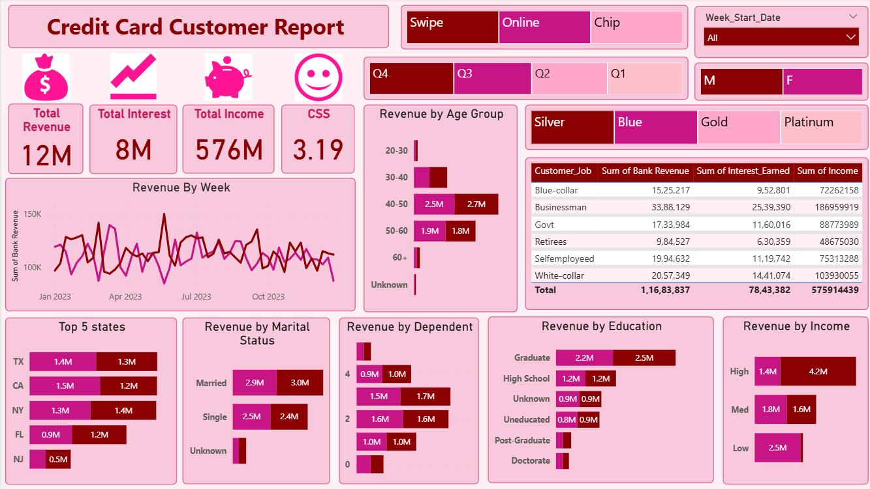
DASHBOARD 2: CREDIT CARD CUSTOMER REPORT
07

Slide 9
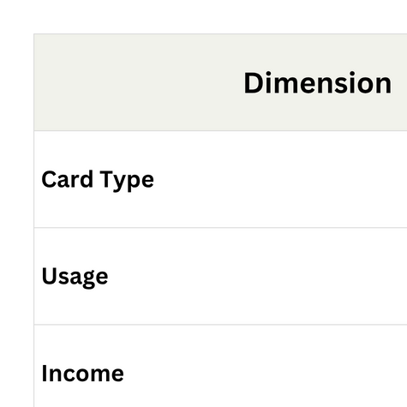
ANALYTICAL INSIGHTS
08

Slide 10
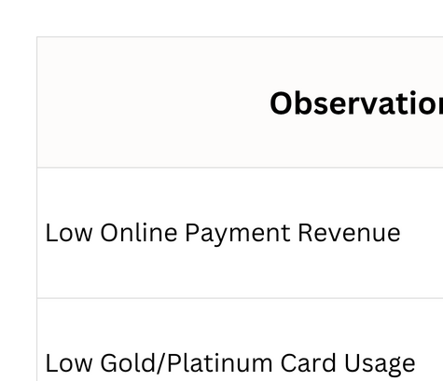

ROOT CAUSE ANALYSIS (RCA)
09

Slide 11

RECOMMENDATIONS
1) Marketing:
Introduce cashback/reward schemes for online and chip usage.
Promote Gold/Platinum cards with visible perks.
2) Customer Retention:
Personalized offers for top income and education groups.
Target campaigns during Q4 to balance seasonal dips.
3) Operational:
Simplify online payment processes.
Train staff for digital support to elderly customers.
10

Slide 12

BUSINESS IMPACT
📈 Projected Outcomes:
+12% revenue increase through loyalty and digital initiatives.
+15% adoption of online/chip payments.
CSS improvement from 3.19 → 3.8.
8–10% higher customer retention with targeted campaigns.
11

Slide 13

LEARNINGS AND SKILLS ACQUIRED
Hands-on with Power BI Dashboard Development.
SQL database integration for clean data handling.
Created KPIs, relationships, slicers, and trend visuals.
Developed skills in data storytelling, RCA, and insights reporting.
12

Slide 14
CONCLUSION
Delivered a complete data-driven analytical solution.
Translated raw transactional data into business insights.
Improved understanding of customer segmentation and revenue mapping.
Strengthened decision-making through Power BI visualization.
13

Slide 15
THANK YOU
14

